Slide 1

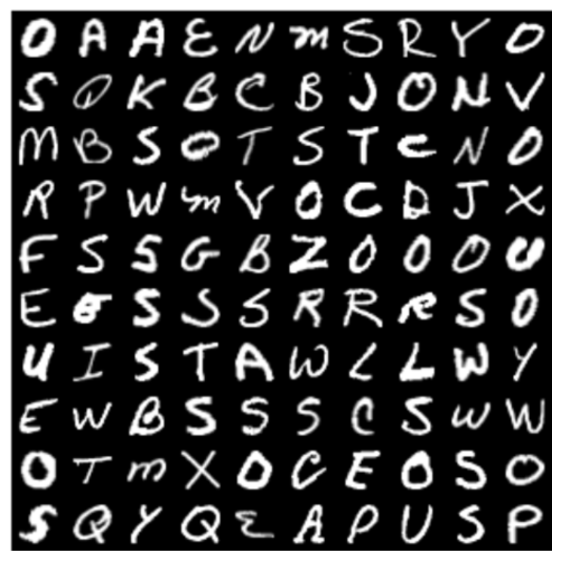

Image Data - Recognising Handwritten Alphabets

Slide 2
Contents
Introduction
Problem Statement
Tools (Libraries) used
Raw Data
EDA(Exploratory Data Analysis)
Building the Model
Observations
Challenges
Conclusion

Slide 3
Introduction
Handwritten alphabet recognition is a fascinating problem in the realm of computer vision and machine learning
The ability to read handwritten characters has a multitude of real-world applications, ranging from digitizing historical documents to improving the efficiency of mail sorting.
In this project, we aim to develop a strong system that can automatically recognize and classify individual letters of the alphabet from a diverse dataset of handwritten characters.

Slide 4
Problem statement
The primary objective of this project is to create a model that can accurately identify handwritten alphabets (A-Z) from image data
We will work with a dataset containing images of handwritten letters, each with its corresponding label indicating the letter it represents.
Our challenge is to build a machine learning model that can effectively handle the variations in writing styles, orientations, and complexities present in the data.

Slide 5






Tools (Libraries) Used
Numpy
Pandas
os
Matplotlib
Seaborn
PIL
Scikit-Learn

Slide 6
MACHINE LEARNING PROJECT LIFECYCLE
Business Understanding
Data Collection
Data Cleaning
Data Analysis
Data Visualization
Preprocessing
Model Building
Model Evaluation
Model Deployment

Slide 7
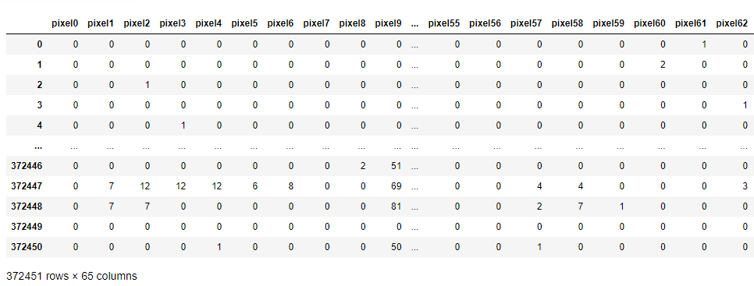

Raw Data

Slide 8
Data Cleaning
Ensure that the labels provided for each image match the content of the image.
Mislabeling can significantly affect model accuracy.
Divide the dataset into training, validation, and test sets while maintaining class balance to ensure the model's ability to generalize.
Identify and handle outliers or erroneous data points that might negatively impact model training

Slide 9
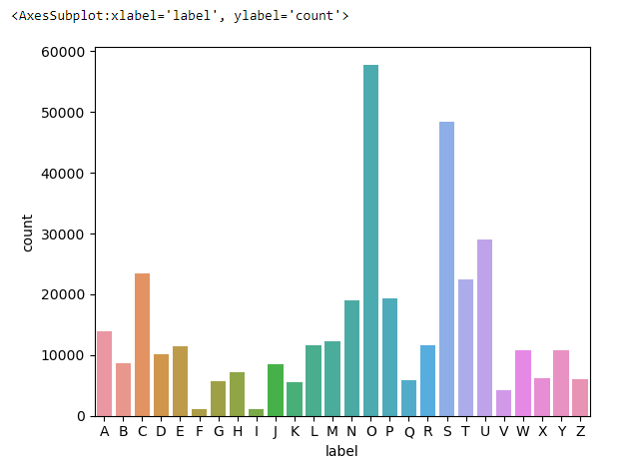
Visualization
Countplot
Alphabet ‘O’ the most frequently occurring letter in the dataset.
Alphabet ‘I’ the least frequently occurring letter in the dataset.
‘O' appears the most frequently (e.g., 57825 times), it is the highest count, and ‘I' appears the least frequently (e.g., 1120 times), it is the lowest count.

Slide 10
PREPROCESSING
Load the image using PIL (Pillow)
Convert the image to grayscale (optional, if not already grayscale)
Resize the image to your desired dimensions ( 28x28 pixels)
Convert the PIL image to a NumPy array
Flatten the NumPy array into a 1 D array
Split your dataset into training, and test sets. This helps assess the model's performance and prevent overfitting.
Target Variable is Label and separate this variable from others
Split dataset into 75 and 25 ratio
Apply filters or denoising techniques to reduce noise and enhance the clarity of handwritten characters.

Slide 11
Model Which I have Used
Decision Tree Algorithm
Random Forest Algorithm
K-Nearest Neighbors Algorithm
AdaBoost Algorithm
Gaussian-NB Algorithm
Logistic Regression Algorithm

Slide 12
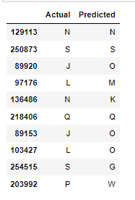
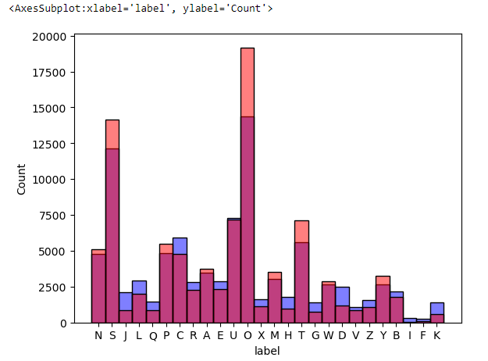
BUILDING THE MODEL
In the Logistic RegressionAlgorithm, alphabet ‘O’ is Highest Predicted Correctly(14,346)
And alphabet ‘S’ is the second highest predicted correctly(12,130)
Accuracy Score of Logistic Regression Algorithm is 0.437662
LOGISTIC REGRESSION ALGORITHM

Slide 13
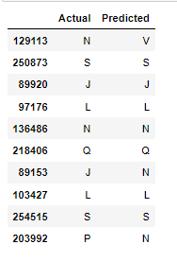
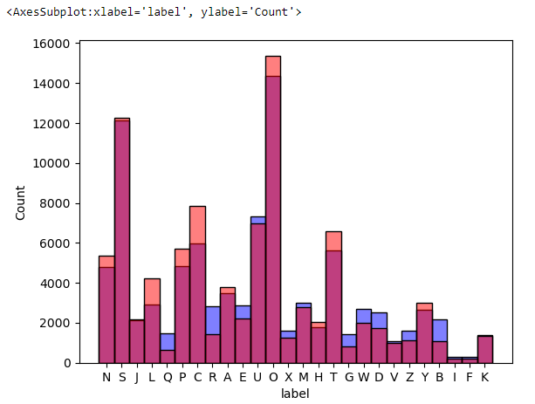
K-NEAREST NEIGHBORS ALGORITHM
In the KNN Algorithm, alphabet ‘O’ is Highest Predicted Correctly(14,346)
And alphabet ‘S’ is the second highest predicted correctly(12,130)
Accuracy Score of K-Nearest Neighbours Algorithm is 0.757596

Slide 14
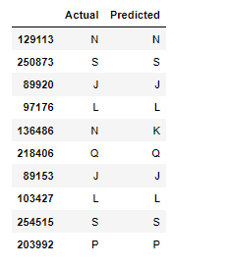
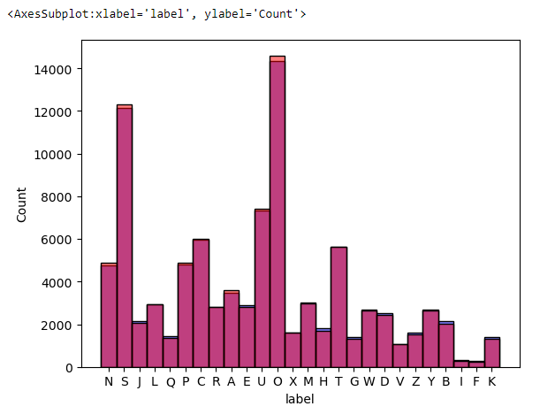
RANDOM FOREST ALGORITHM
In the Random Forest Algorithm, alphabet ‘O’ is Highest Predicted Correctly(14,346)
And alphabet ‘S’ is the second highest predicted correctly(12,130)
Accuracy Score of Random Forest Algorithm is 0.974268

Slide 15
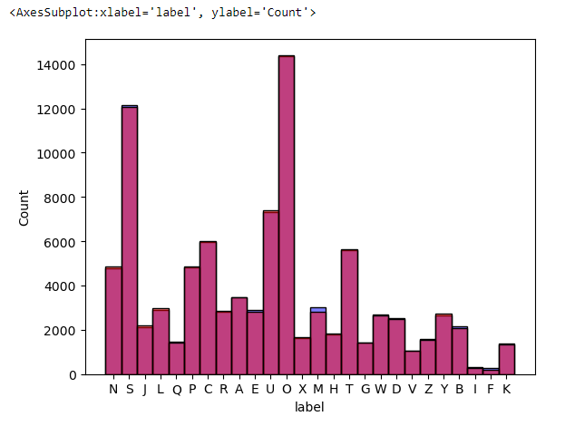
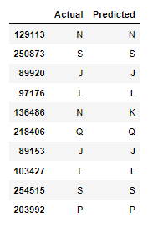
DECISION TREE ALGORITHM
In the Decision Tree Algorithm, alphabet ‘O’ is Highest Predicted Correctly(14,346)
And alphabet ‘S’ is the second highest predicted correctly(12,130)
Accuracy Score of Decision Tree Algorithm is 0.926476

Slide 16
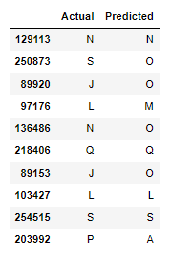
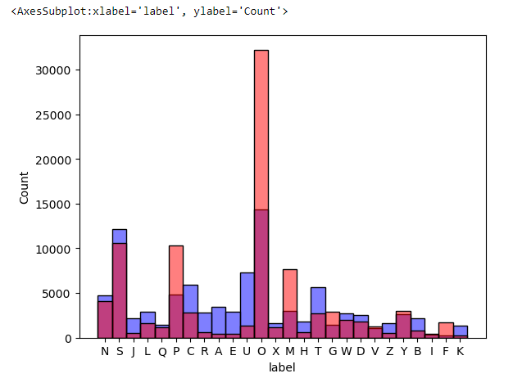
GAUSSIAN-NB ALGORITHM
In the Gaussian-NB Algorithm, alphabet ‘O’ is Highest Predicted Correctly(14,346)
And alphabet ‘S’ is the second highest predicted correctly(12,130)
Accuracy Score of Gaussian-NB Algorithm is 0.441797

Slide 17
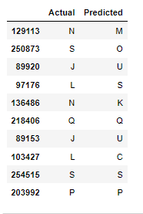
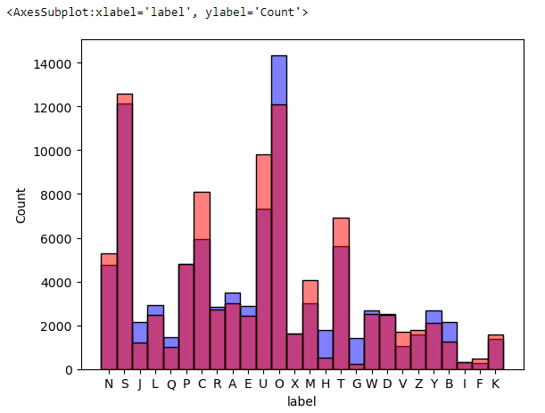
ADABOOST ALGORITHM
In the AdaBoost Algorithm, alphabet ‘O’ is Highest Predicted Correctly(14,346)
And alphabet ‘S’ is the second highest predicted correctly(12,130)
Accuracy Score of AdaBoost Algorithm is 0.553822

Slide 18
Model Evaluation
In this Evaluation part calculate Accracy,precision,recall,f1-score for each and every Algorithm
Create confusion Matrix for all algorithm
And also Create Classification reports
Comparing which Algorithm’s Accuracy score is high
After comparing all Random Forest and Decision Tree is best Algorithm in term of Accuracy

Slide 19
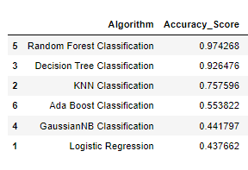
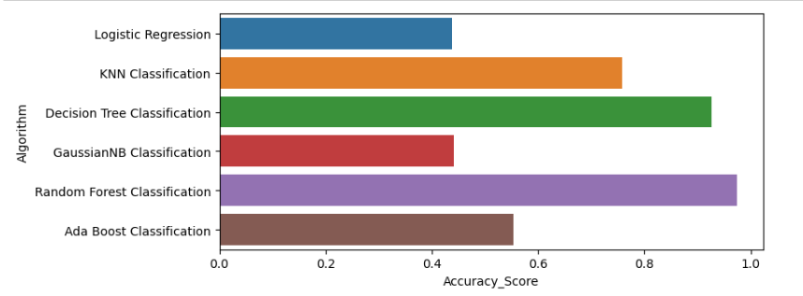
Accuracy score of Different Algorithm

Slide 20
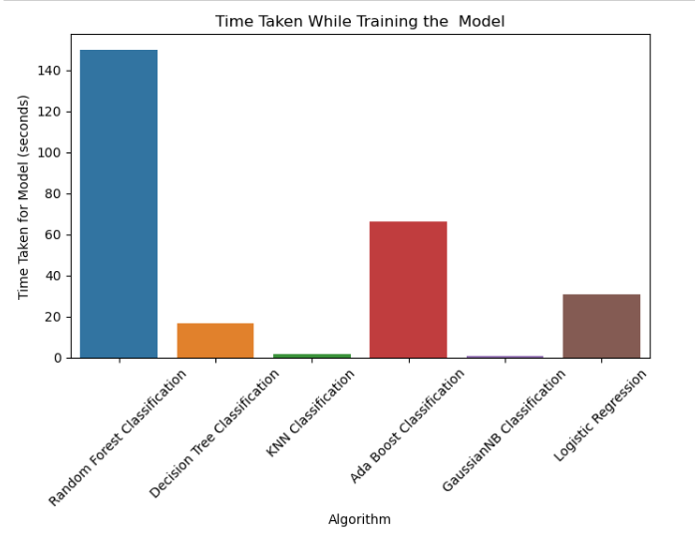
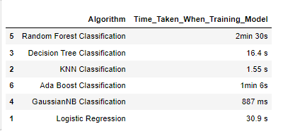
TIME TAKEN FOR TRAINING THE MODEL

Slide 21
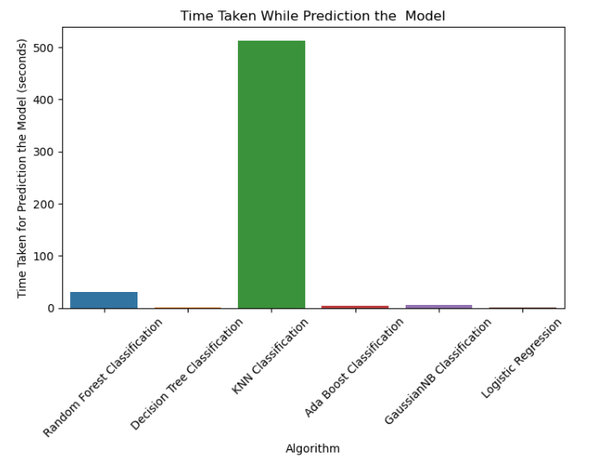
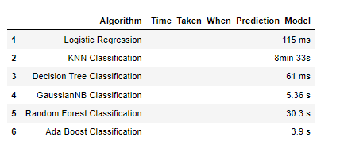
TIME TAKEN FOR PREDICTION THE MODEL

Slide 22
Conclusion
After making predictions on handwritten alphabets, we can conclude whether the recognition system successfully identified the letters in the given images
The quality of predictions based on the model and data preprocessing
from the above model it has been seen that Random Forest achieve highest accuracy with 97.4 % and Decision Tree is 92.6 %.

Slide 23
Challenges
People write letters differently, making it hard for a system to recognize them accurately.
Connected letters in cursive can be tricky to separate and identify.
Letters can appear in different sizes and orientations in images.
When letters overlap, it's hard to recognize each one separately.
Some handwritten letters may look like more than one letter.

Slide 24


Slide 25


